Slide 1

Problems on Testing 2010

Slide 2
Reference
Data
Youtube
Code

Slide 3
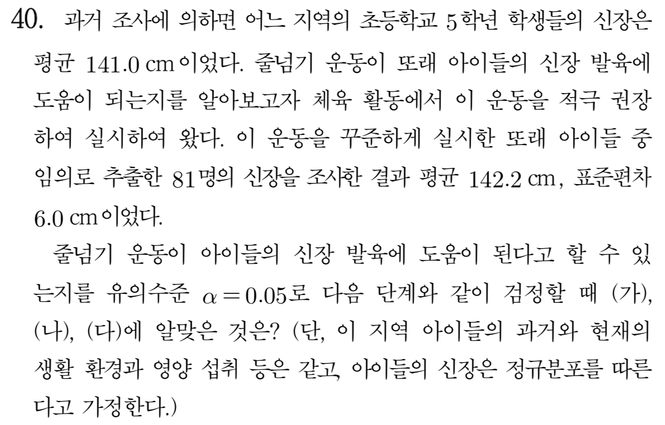
[2010]

Slide 4
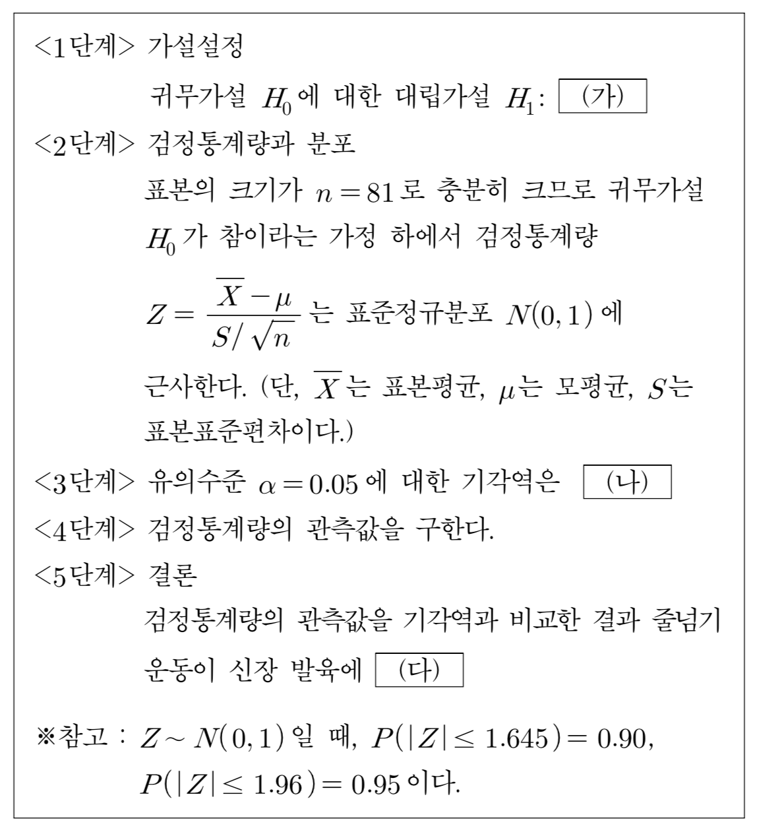
[2010]

Slide 5
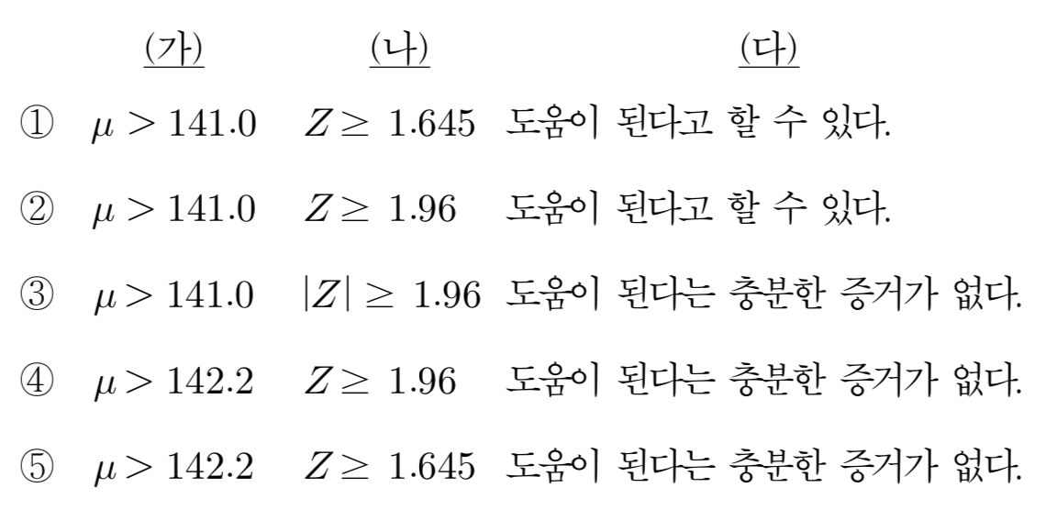
[2010]

Slide 6
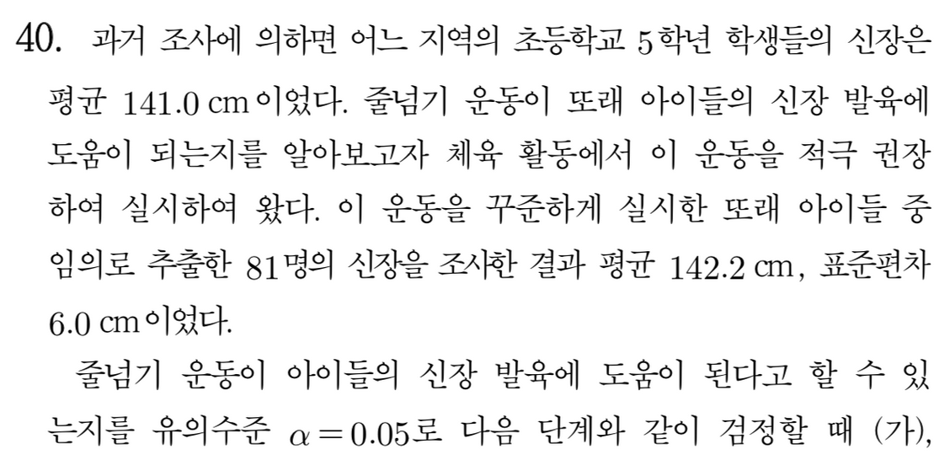

Slide 7


Slide 8


Slide 9
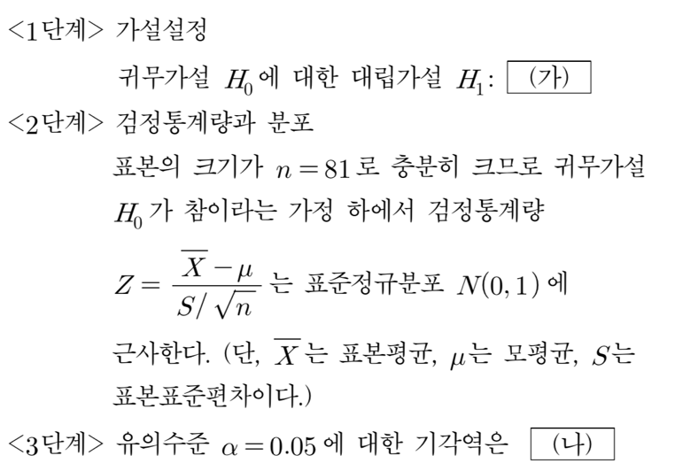


Slide 10


